Slide 1

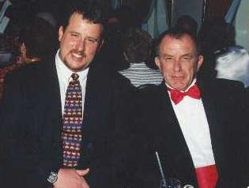
Exposure CS 2021
for CS1
Chapter 8 Section 6 Slides
Combining Repetition with
Traditional Graphics
PowerPoint Presentation
created by:
Mr. John L. M. Schram
and Mr. Leon Schram
Authors of Exposure
Computer Science

Slide 2
Section 8.6
Using Repetition with
Traditional Graphics

Slide 3
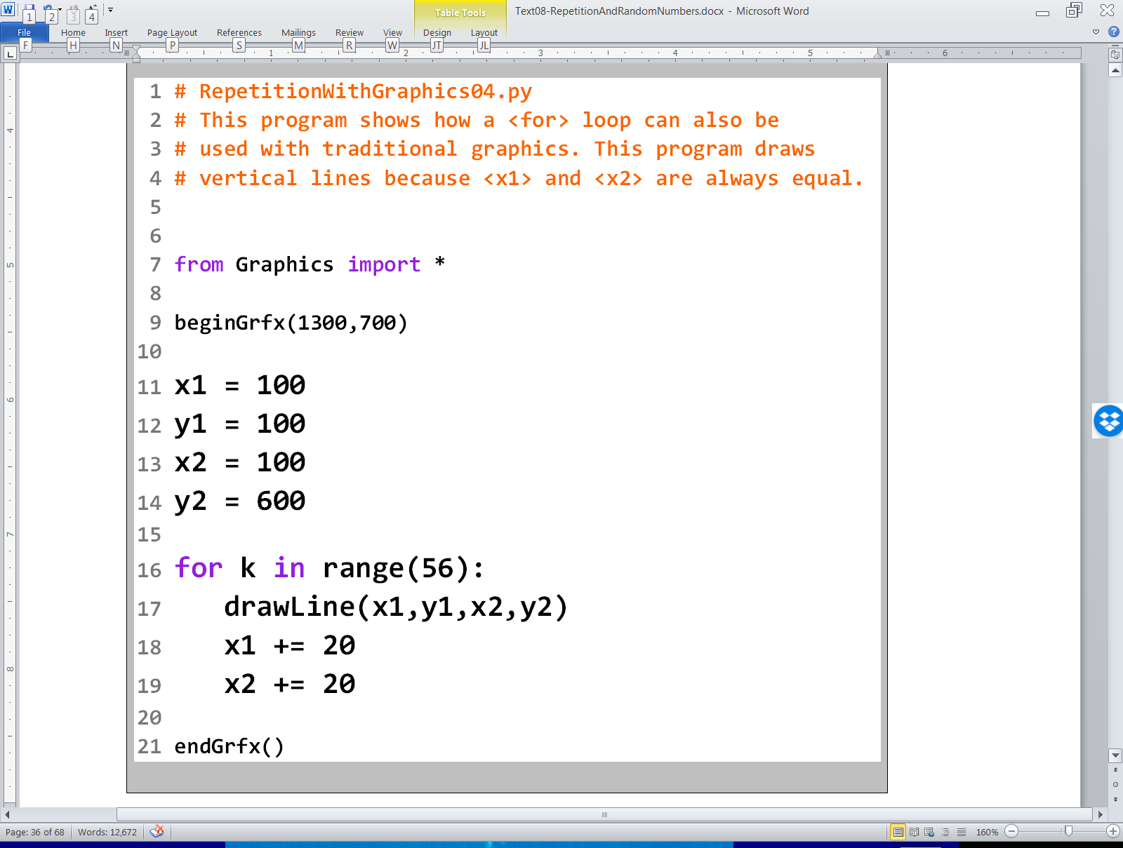

Slide 4
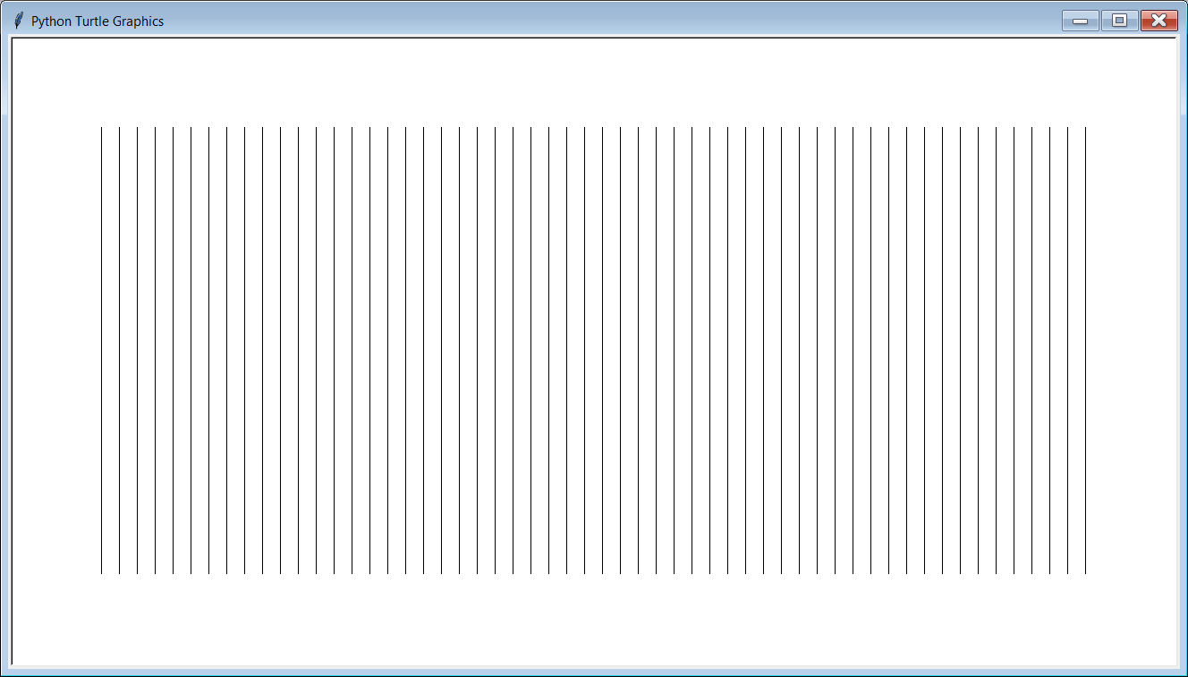

Slide 5
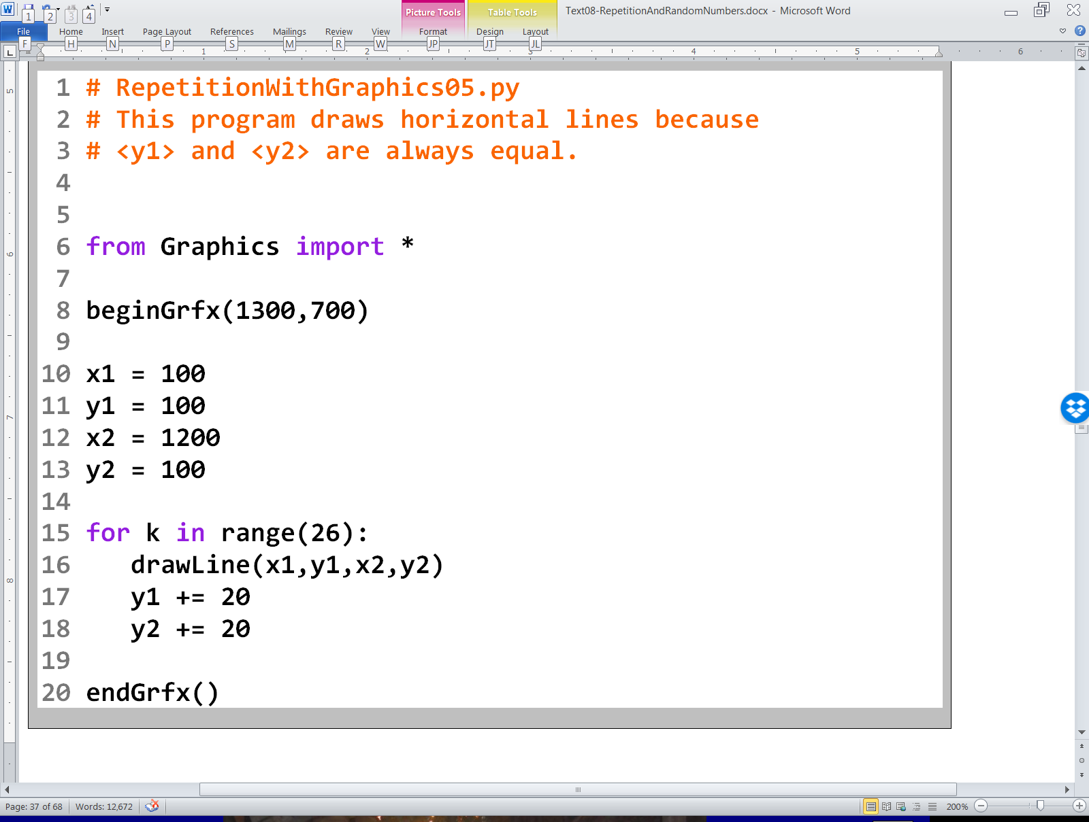

Slide 6
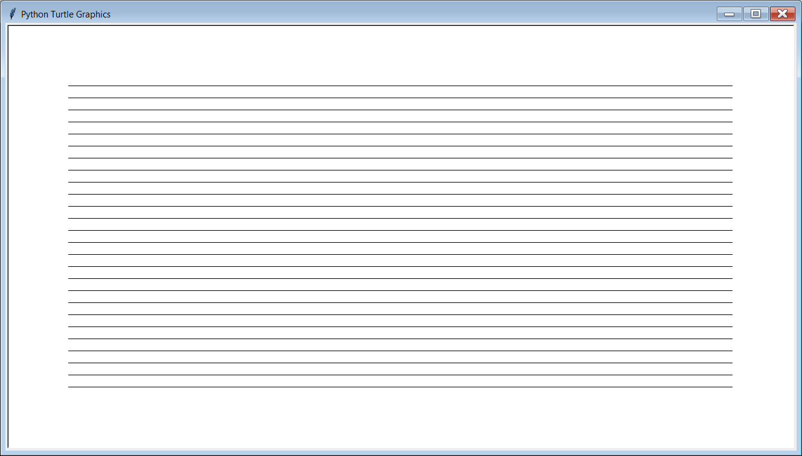

Slide 7
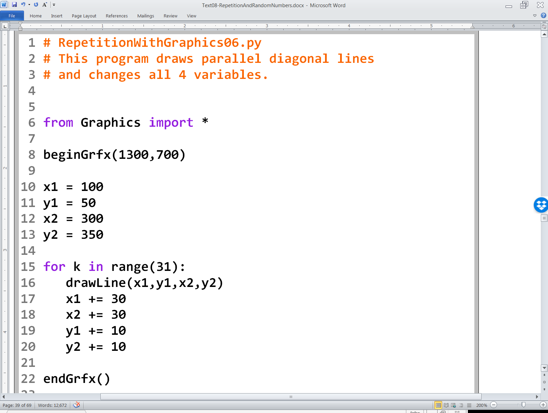

Slide 8
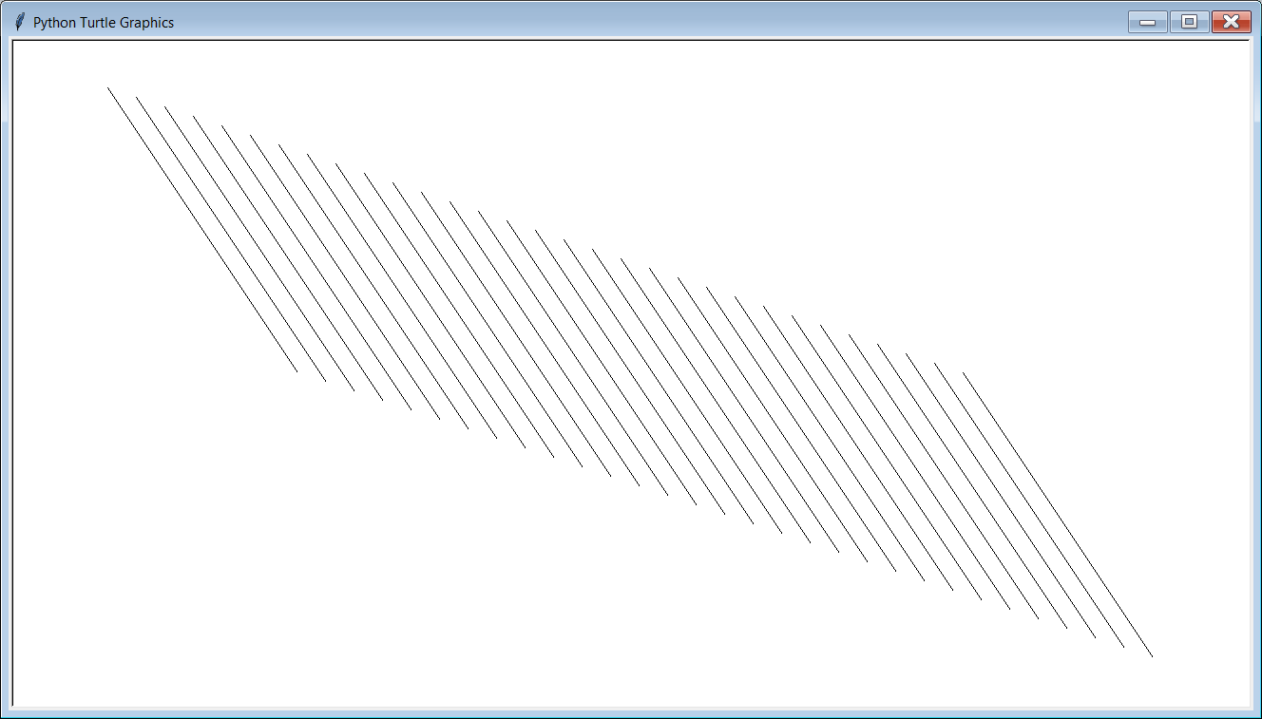

Slide 9
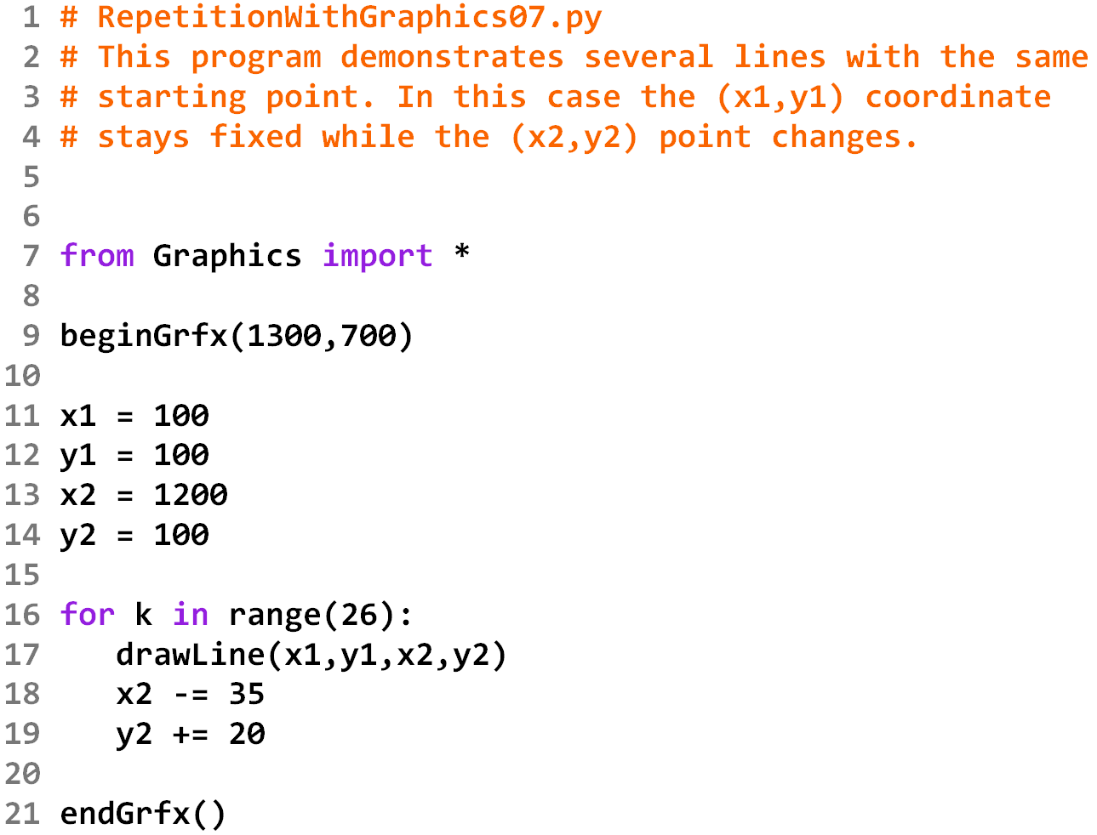

Slide 10
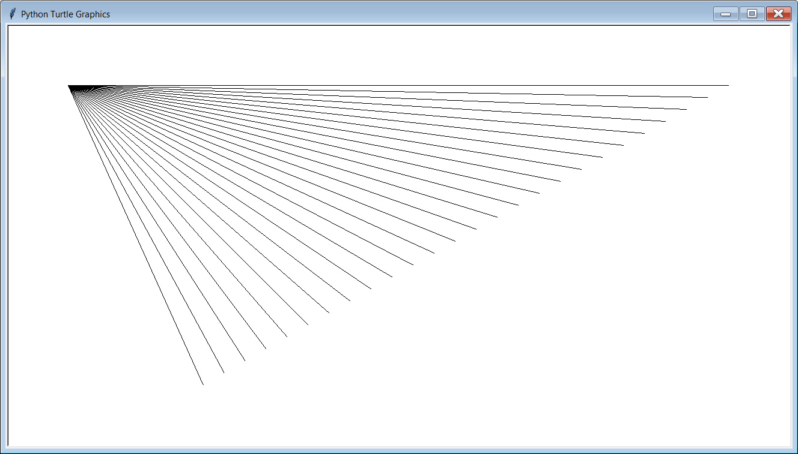

Slide 11
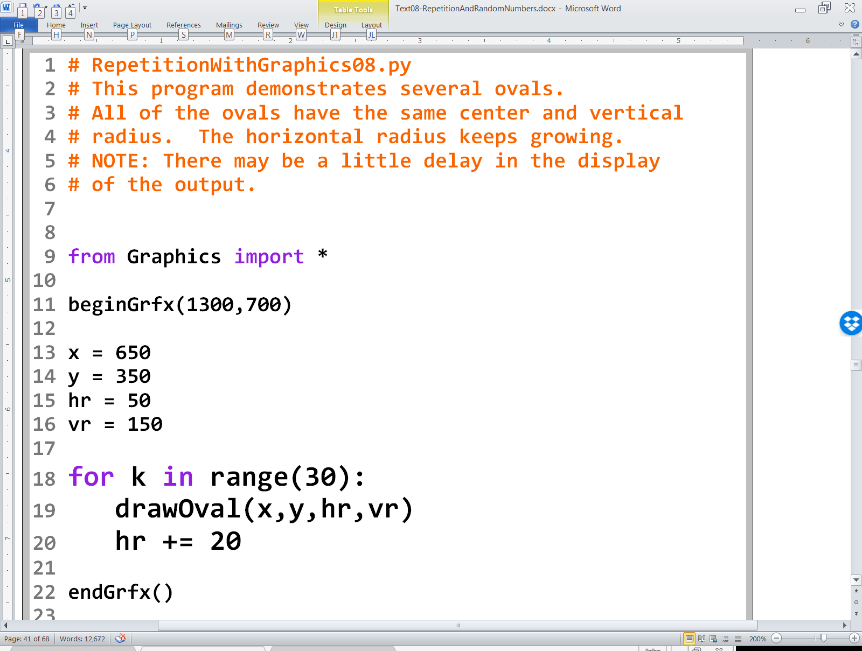

Slide 12
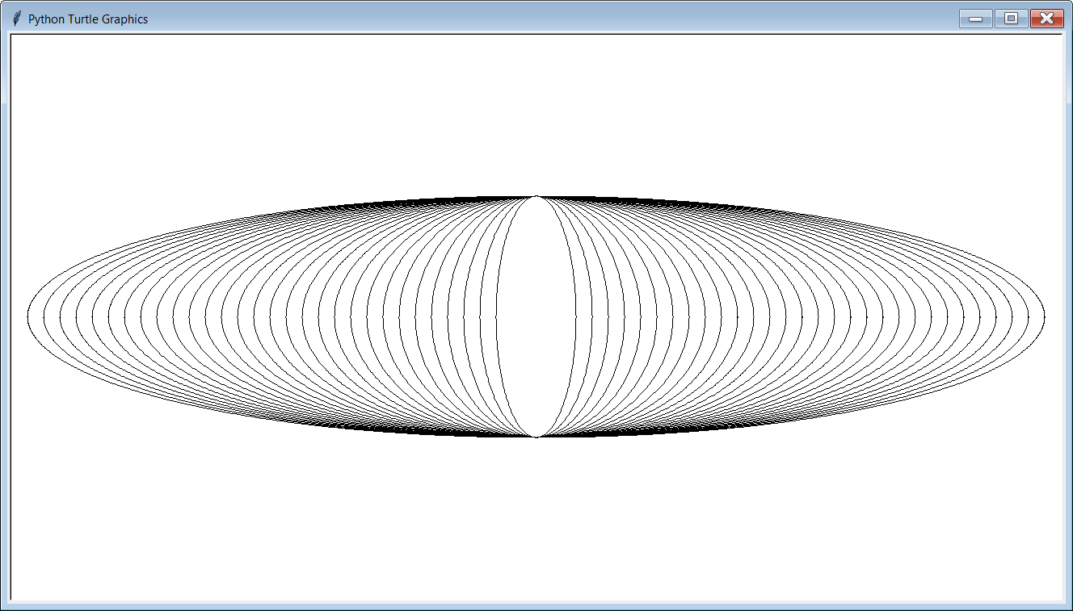

Slide 13
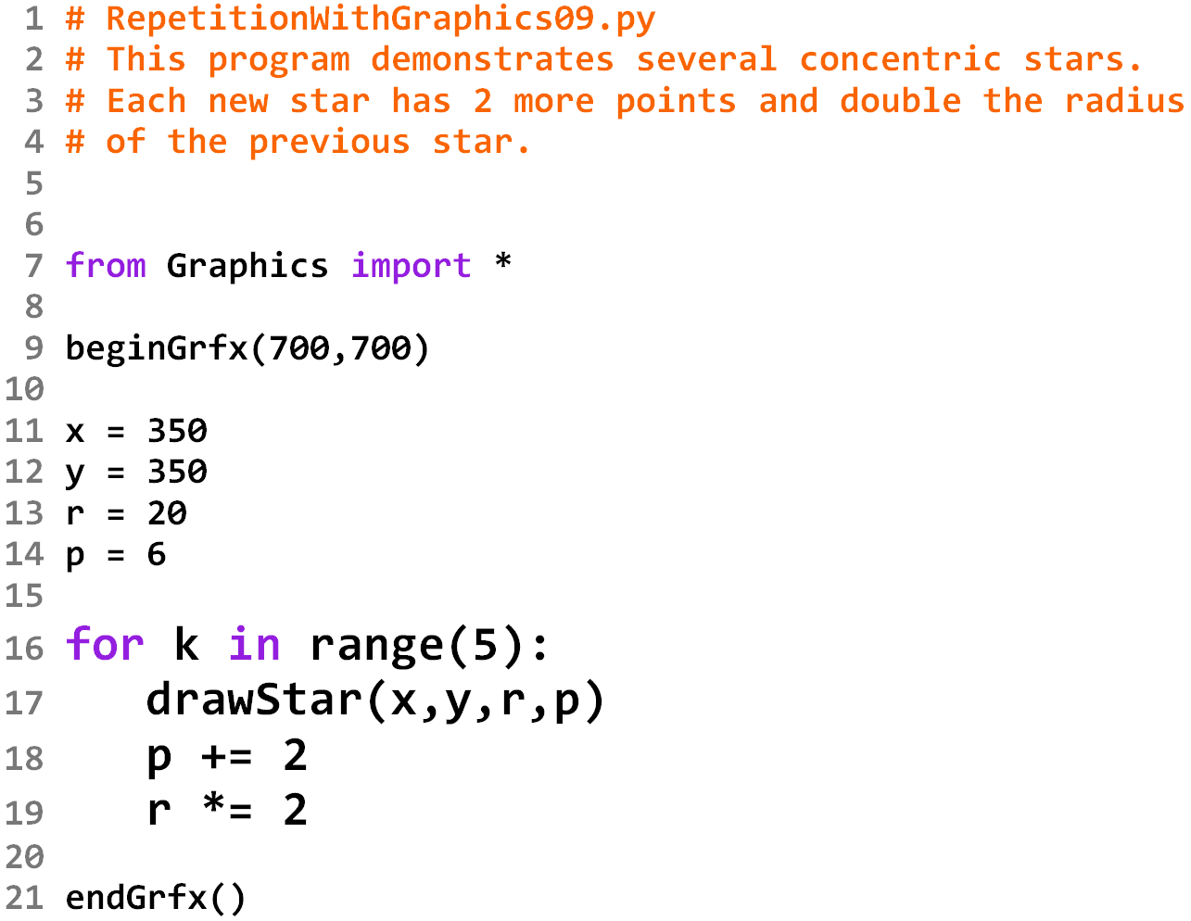

Slide 14
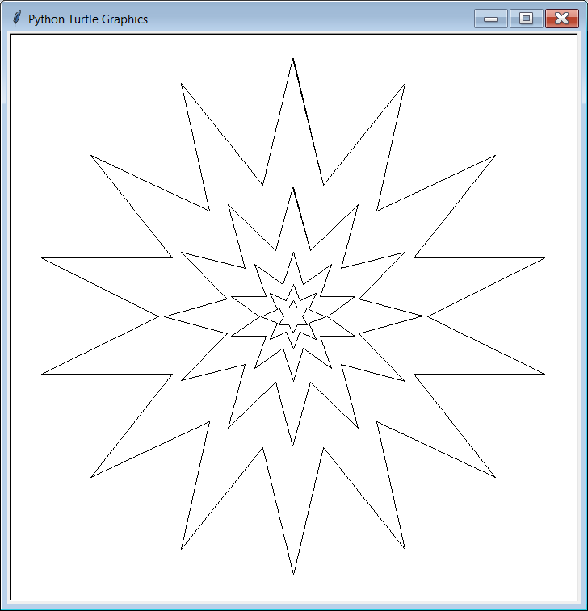

Slide 15
Lab 8B
What you saw in the past 6 program examples relates directly to what
you will be doing in Lab 8B.

